Slide 1
BINARAY LOGISTIC REGRESSION MODEL PERFORMANCE

Slide 2
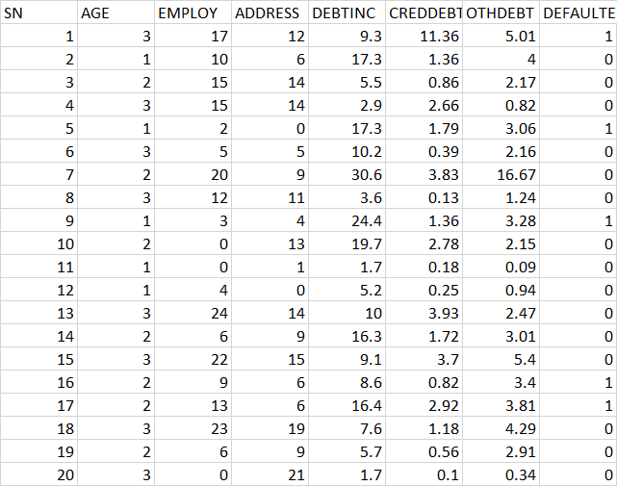
Data Snapshot
Bank Loan Data
Independent Variables
Dependent Variable
Column | Description | Type | Measurement | Possible Values
SN | Serial Number |  | - | -
AGE | Age Groups | Categorical | 1(<28 years), 2(28-40 years), 3(>40 years) | 3
EMPLOY | Number of years customer working at current employer | Continuous | - | Positive value
ADDRESS | Number of years customer staying at current address | Continuous | - | Positive value
DEBTINC | Debt to Income Ratio | Continuous | - | Positive value
CREDDEBT | Credit Card Debt | Continuous | - | Positive value
OTHDEBT | Other Debt | Continuous | - | Positive value
DEFAULTER | Whether customer defaulted on loan | Binary | 1(Defaulter), 0(Non-Defaulter) | 2
Observations

Slide 3
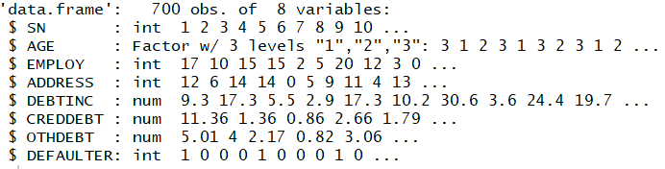
Binary Logistic Regression in R
# Import data and check data structure before running model
data<-read.csv("BANK LOAN.csv",header=TRUE) str(data)
data$AGE<-factor(data$AGE) str(data)

Slide 4
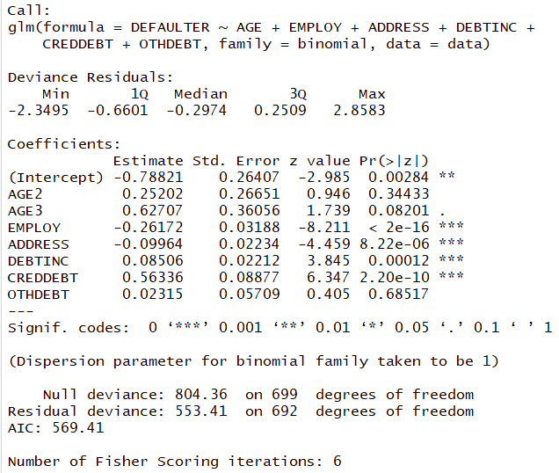
Binary Logistic Regression in R
riskmodel<-glm(DEFAULTER~AGE+EMPLOY+ADDRESS+DEBTINC+CREDDEBT+OTHDEBT,family=binomial,data=data) summary(riskmodel)
Interpretation :
Since p-value is <0.05 for Employ, Address, Debtinc, Creddebt, these independent variables are significant.

Slide 5
Re-run Model in R
Re-run the model with employ, address, debtinc, creddebt.
riskmodel<-glm(DEFAULTER~EMPLOY+ADDRESS+DEBTINC+CREDDEBT, family=binomial,data=data) summary(riskmodel)

Slide 6
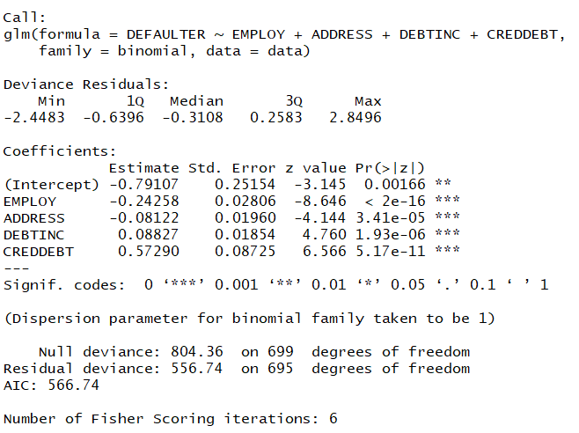
Re-run Model in R
# Output:
Interpretation :
Since p-value is <0.05 for Employ, Address, Debtinc, Creddebt, these independent variables are significant and sign of the coefficients are also logical.

Slide 7
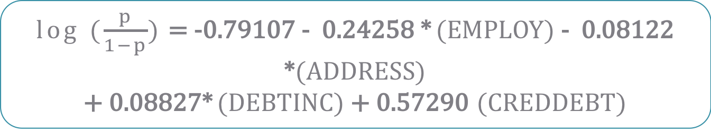
Final Model
Final Model is :
This model is used for predicting the probabilities.
log ($\frac{p}{1−p}$) = -0.79107 - 0.24258 * (EMPLOY) - 0.08122 *(ADDRESS)
+ 0.08827* (DEBTINC) + 0.57290 (CREDDEBT)

Slide 8
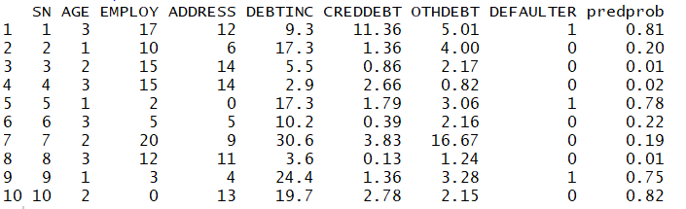
Predicting Probabilities in R
# Predicting Probabilities
data$predprob<-round(fitted(riskmodel),2) head(data,n=10)
Last column in the data ‘predprob;’ is the probabilities generated using final model.

Slide 9
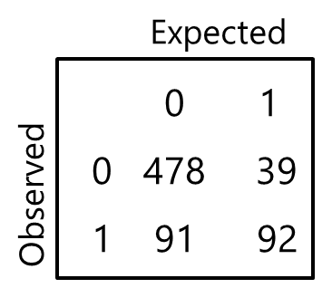
Classification Table
Based on cut-off value of p, Y is estimated to be either 1 or 0
Ex. p>0.5 ; Y=1
p≤0.5 ; Y=0
Cross tabulation of observed values of Y and predicted values of Y is called as Classification Table.
The predictive success of the logistic regression can be assessed by looking at the classification table, but classification table is not a good measure of goodness fit since it varies with the cut off value set.
Accuracy Rate measures how accurate a model is in predicting outcomes.
In the adjoining table, 479 times Y=0 was observed as well as predicted. Similarly, Y=1 was observed and predicted 92 times.
Accuracy Rate = 479+92/700 = 81.571
479
38

Slide 10
Misclassification
Misclassification Rate → Percentage of wrongly predicted observations
Note that misclassification rate depends on cut off used for predictions
Suppose our classification table looks as follows:
Here misclassification rate is : (38 +91) / 700=18.43%
479
38

Slide 11
Classification Table Terminology
Sensitivity | % of occurrences correctly predicted P(Ypred=1/Y=1)
Specificity | % of non occurrences correctly predicted P(Ypred=0/Y=0)
False Positive Rate (1 – Specificity) | % of non occurrences which are incorrectly predicted. P(Ypred=1/Y=0)
False Negative Rate (1- Sensitivity) | % of occurrences which are incorrectly predicted. P(Ypred=0/Y=1)
 |  | Predicted
 |  | 0 | 1
Observed | 0 | Specificity | False Positive (1-Specificity)
 | 1 | False Negative (1-Sensitivity) | Sensitivity

Slide 12

Classification and Sensitivity and Specificity table in R
# Predicting Probabilities
classificationtable<-table(data$DEFAULTER,data$predprob > 0.5) classificationtable
table function will create a cross table of observed Y (defaulter) vs. predicted Y
# Output:
Interpretation :
True indicates predicted defaulters and False indicates predicted non-defaulters.
There are 479 correctly predicted non-defaulters and 92 correctly predicted defaulters.
There are 38 wrongly predicted as defaulters and 91 wrongly predicted as non-defaulters.

Slide 13
Sensitivity and Specificity in R
# Sensitivity and Specificity
sensitivity<-(classificationtable[2,2]/(classificationtable[2,2]+classificationtable[2,1]))*100 sensitivity specificity<-(classificationtable[1,1]/(classificationtable[1,1]+classificationtable[1,2]))*100 specificity
# Output:
sensitivity [1] 50.27322 specificity [1] 92.6499
Interpretation :
The Sensitivity is at 50.3% and the Specificity is at 92.7% . This is when the cutoff was set at 0.5

Slide 14
Sensitivity and Specificity calculations
Cut-off Value
0.1
0.2
0.3
0.4
0.5
Accuracy | Sensitivity | Specificity
(245+171)/700 = 60.4% | 171/183=93.4% | 245/517=48.7%
(352+155)/700 = 72.4% | 155/183=84.7% | 352/517=68.1%
(415+137)/700 = 78.9% | 137/183=74.9% | 415/517=80.3%
(449+113)/700 = 80.14% | 113/183=61.7% | 449/517=86.8%
(479+92)/700 =81. 57% | 92/183=50.3% | 479/517=92.6%
FALSE TRUE
0 252 265
1 12 171
FALSE TRUE
0 352 165
1 28 155
FALSE TRUE
0 415 102
1 46 137
FALSE TRUE
0 449 68
1 70 113
FALSE TRUE
0 479 38
1 91 92
*
Note : Here we are trying to find out the best cut-off value based on accuracy, sensitivity & specificity.

Slide 15
Receiver Operating Characteristic Curve
The Receiver Operating Characteristic (ROC) curve is
Y- axis: Sensitivity ( true positive rate)
X-axis: 1-Specificity (false positive rate)
The performance of the classification model can be assesed by area under the ROC curve (C).
A graphical representation of the trade off between the false positive and true positive rates for various cut off values

Slide 16
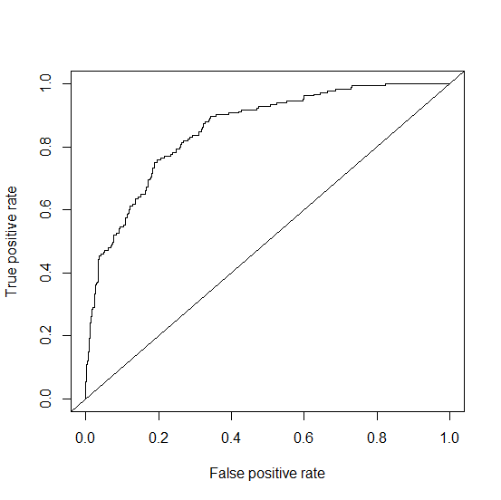
ROC Curve and Area Under ROC Curve
Fig. 01: ROC Curve
True Positive Rate
False Positive Rate
High TPR with low FPR is indicative of a good model. This will result in curve that is closer to the Y-axis and top left corner of the plot. It implies higher Area Under the ROC Curve.

Slide 17
ROC Curve and Area Under ROC Curve
Interpreting different versions of an ROC curve
If the model is perfect, AUC = 1
If the model is guessing randomly, AUC = 0.5
Thumb rule: Area Under ROC Curve > 0.65 is considered acceptable
Critical Points | Interpretations
TPR = 0 and FPR = 0 | Model predicts every instance to be Non-event
TPR = 1 and FPR = 1 | Model predicts every instance to be Event
TPR = 1 and FPR = 0 | The Perfect Model

Slide 18
ROC in R
# Install and Load “ROCR” package.
install.packages("ROCR") library(ROCR) data$predprob<-fitted(riskmodel) pred<-prediction(data$predprob,data$DEFAULTER) perf<-performance(pred,"tpr","fpr") plot(perf) abline(0,1)
prediction() function prepares data required for ROC curve.
performance() function creates performance objects, "tpr“ (True positive rate), "fpr” (False positive rate).
plot() function plots the objects created using performance
abline() adds a straight line to the plot.

Slide 19
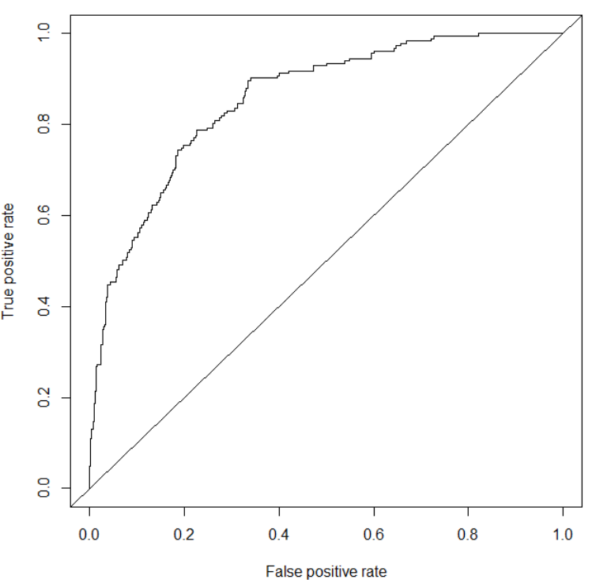
ROC in R
# Output:
auc<-performance(pred,"auc") auc@y.values [1] 0.8556193
Gives area under curve (AUC)
Interpretation :
Area under the curve is 0.8556 which means model is performing well.

